Slide 1

Notes:
PRIVATE SOCIAL INVESTMENT FUND
to end violence against women and girls

Slide 2

When it comes to violence against women in Brazil, the numbers were already high, but the pandemic made this SITUATION ALARMING and the consequences have lasted to this day.

Slide 3

1 in every 4 women in Brazil (24.4% = equal to
17 million women) over the age of 16 say that they suffered some kind of violence or aggression in 2020 (last 12 months), during the covid-19 pandemic;
5 in every 10 Brazilians (51.1%) say that they've witnessed a woman being subjected to some sort of violence in their neighborhood or community during this time;
8 women physically assaulted each minute.
Source: Visible and Invisible Survey - FBSP/ 2021

Slide 4






Solution
Instituto Avon and Accor Hotels have decided to join forces in creating the Private Social Investment Fund to put an end to violence against women and girls.
Proposal
Union and collaboration among all sectors of society:
the government, companies, and civil society, supporting public protective services and offering temporary housing, psychological and legal support, and material aid to women in violent situations, helping them to restart and rewrite their stories.

Slide 5


Slide 6

How does it work?
Shelter
Legal, psychological and social aid support
Alternative refuge in hotels for women and their dependents in violent situations, and financial support to improve shelters.
for women and their companions during their stay
at hotels.
Stronger public policies
Material Aid
Foster government engagement and commitment to confronting violence, qualifying and expanding services offered, while also promoting articulation between the entities that make up the network.
Fulfillment of the basic and immediate needs of women in violent situations, reducing extreme economic vulnerability

Slide 7
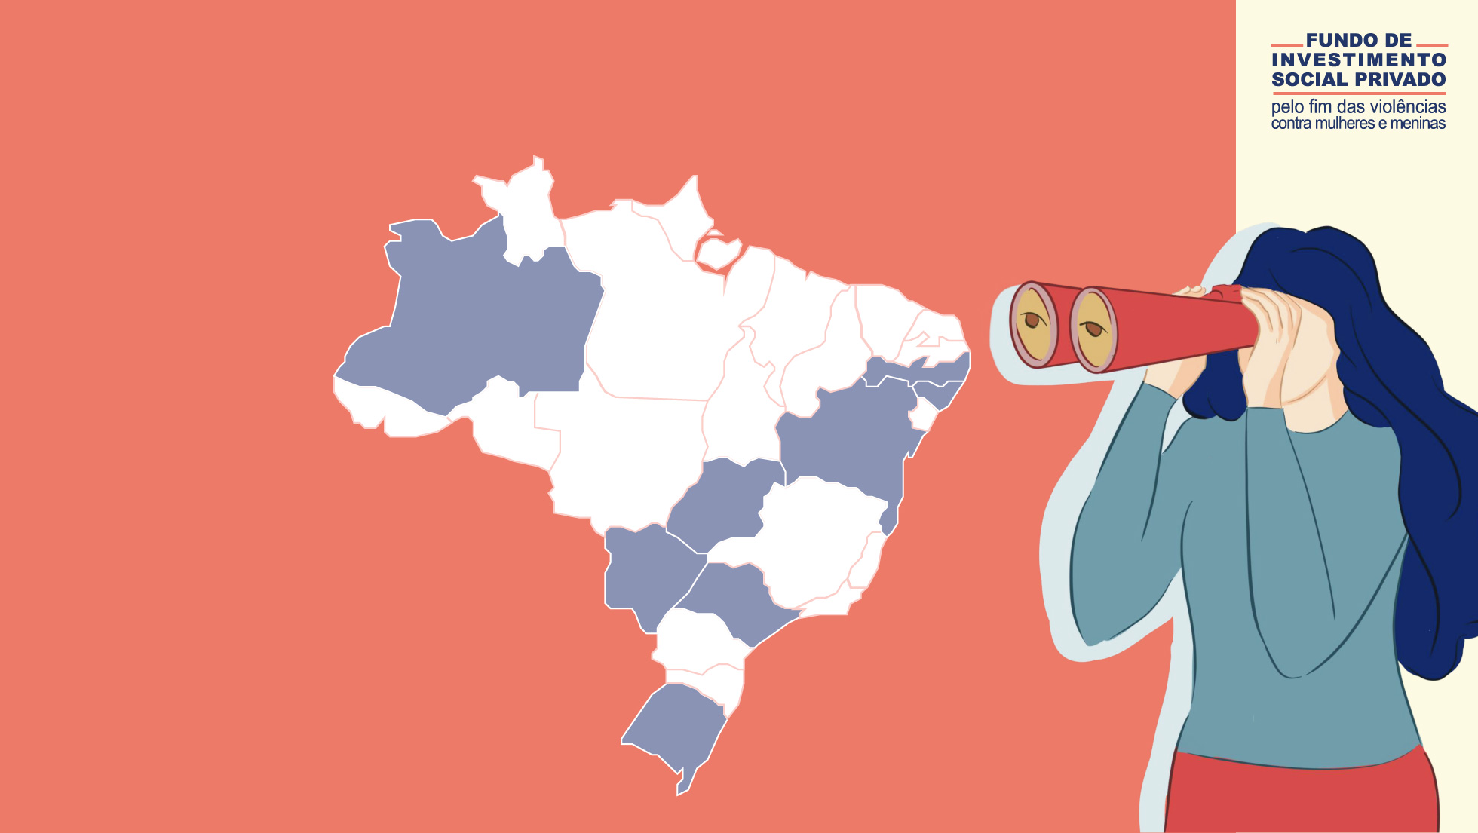
Growth in our network from Jan/2020 to Oct/2022.
1871
agents of anti-violence networks impacted by the program;
301
municipalities in 22 states;
7 states with signed cooperation agreements – 2 consortiums:
AL, AM, BA, GO, MS, PE, RS ABC, CONDEMAT.
Last updated: October 2022.

Slide 8

See the impact of the project from Jan/2020 to Oct/2022. The numbers are growing daily:
2145 nights of hotel stays donated;
196 women + 241 companions stayed at Accor chain hotels;
225 other types of municipal services;
R$210,000 in food cards donated;
7 shelter homes supported in six states – R$800,000;
6491 women served by activities offered at homes supported;
650 beneficiaries and dependents received food assistance.
Last updated: October 2022.

Slide 9

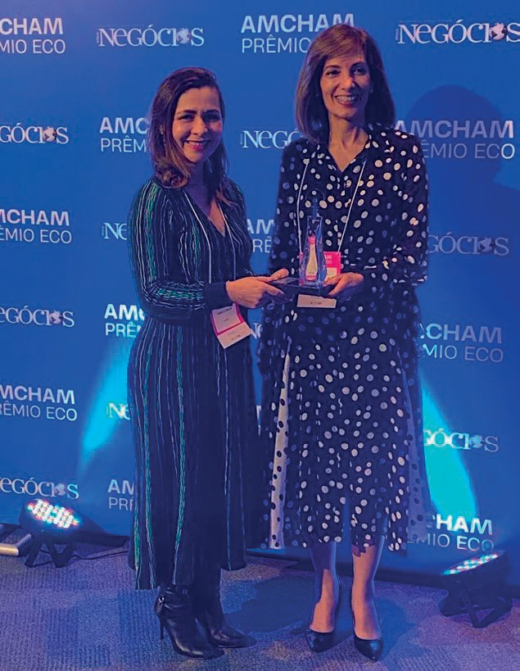
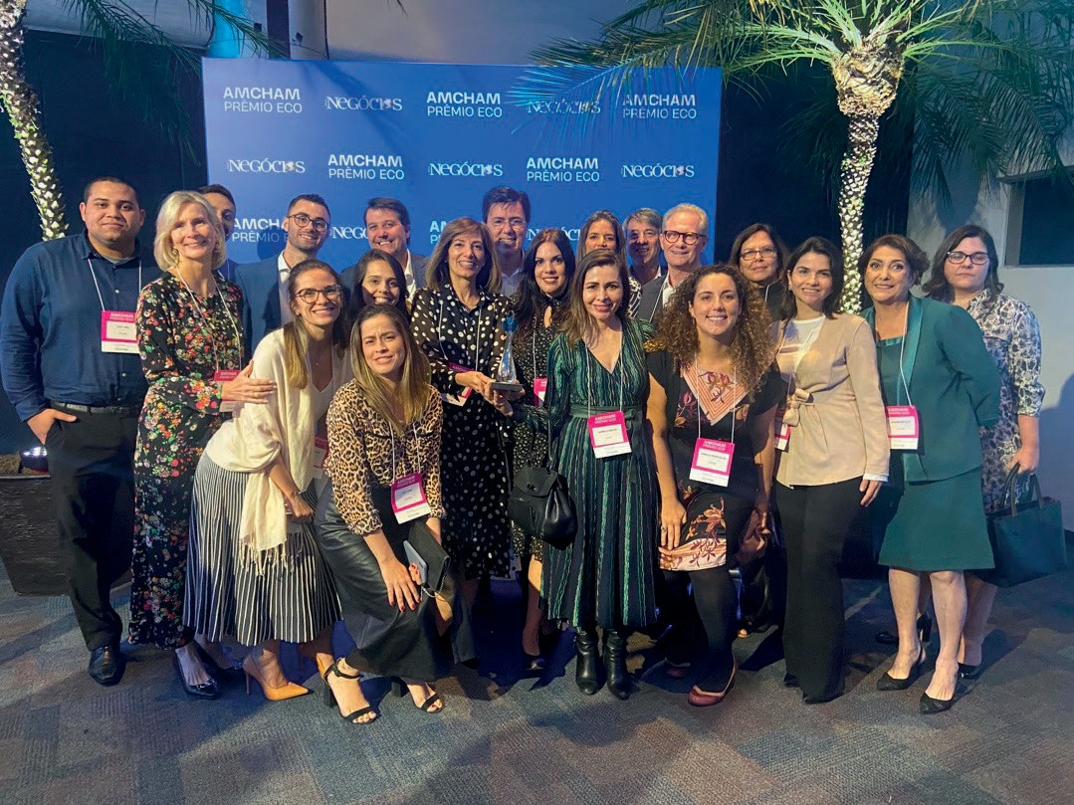
We won the ECO 2022 Award
"Sustainable Practices in Products and Services"

Slide 10
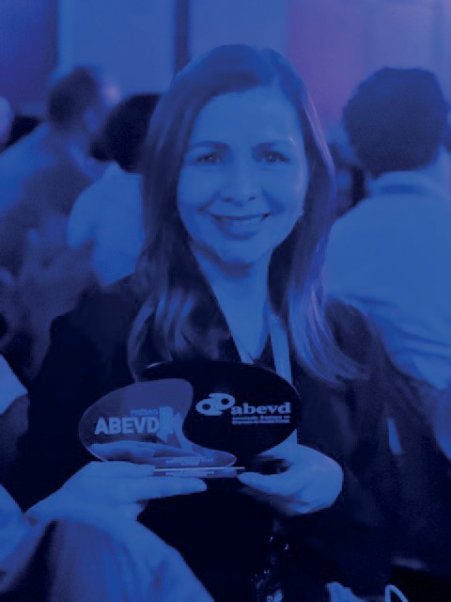

We won the ABVED Award
National Recognition

Slide 11

Fund Management
Expertise, commitment, and transparency in accounting
Since 2003, Instituto Avon has supported and developed initiatives aimed at breast cancer care and at confronting violence against women and girls.
Since its founding 50 years ago, Accor has been present in over 5000 hotels in 110 countries, with consistent action in the social area.
IDIS is
responsible for program management of the fund and for monitoring.
SITAWI
Finanças do Bem is responsible for financial management of the fund.
Bem Querer Mulher provides psychological and social assistance for women in the program.

Slide 12
Future outlook
Expand and improve the public system for sheltering and protecting women in violent situations across Brazil, allowing them to restart and rewrite their stories.
2022
Private Social Investment Fund
becomes permanent.
2020
Methodology for local networks, mapping of bottlenecks and development of flows for public policy to work.
Creation of the Private Social Investment Fund.

Slide 13

Why invest in the PSI Fund?
Innovative initiative;
Applicable to public policies;
Nationwide coverage;
Technical and legal support from specialists and monitoring and assessment;
Accountability of services and of the public network;
Customized responses focused on victims' need.

Slide 14

How do we get there?
We want to expand our presence to another 4 states by 2024;
We want to consolidate our presence in the 20 states were we are active at this time;
To ensure that actions function fully, R$ 2 MM is needed per year;
We want to raise R$ 6 MM in the next 2 years.

Slide 15

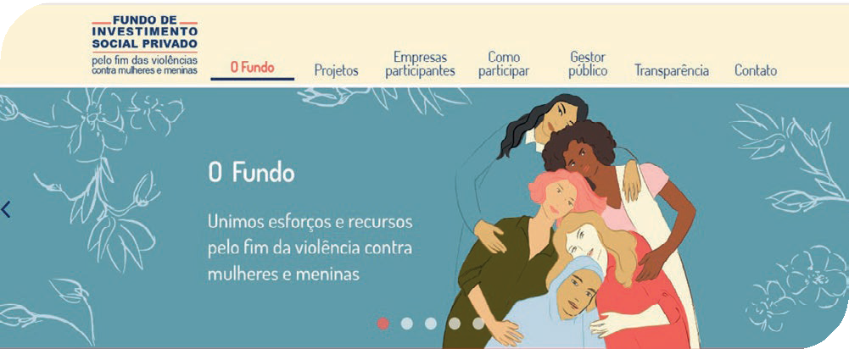
Thank you!
For questions contact:
renata.rodovalho@avon.com
Website: fundoisp.com.br

