Slide 1


Slide 2
Our Strengths | Added Value
Years of experience History | Reliability

Slide 3
Structure:
Capa (com logo)
”Executive Summary” (opcional pag adicional, ou menu lateral)
Quem somos
  (breve copy sobre anos de experiência, história da agência, porquê existimos) = adicionar pessoalidade; proximidade, e reliability)
  Sao Paulo, BR – Miami, U.S.
  Instagram
Valores, Missão e Visão (x projects completed, y years of experience, t different clients, y awards)
Meet Our Team (future)
Experience (logos de marcas que ja trabalhamos) - credibility

Slide 4
Solutions Overview:
De forma objetiva e até com infográficos, os serviços que oferecemos
  Branding Lab (brand launch and management)
  Marketing & Advertising Strategy (assessment, strategy and activation plan)
  Digital studio (web design, email marketing, SEO optimization, social media campaigns, e-commerce)
  Creative studio (graphic design – creative copy – print )
  Events
Portfolio (divided into sections above)

Slide 5
How We Work: so clients know what to expect and already get a sense of
  Assessment – or Intro call…
  Strategic Planning
  Proposal
  .. Etc (TBD)
Testimonials
Problem with stats > solutions + CTA
Contato, e CTA – schedule a consultation with us

Slide 6
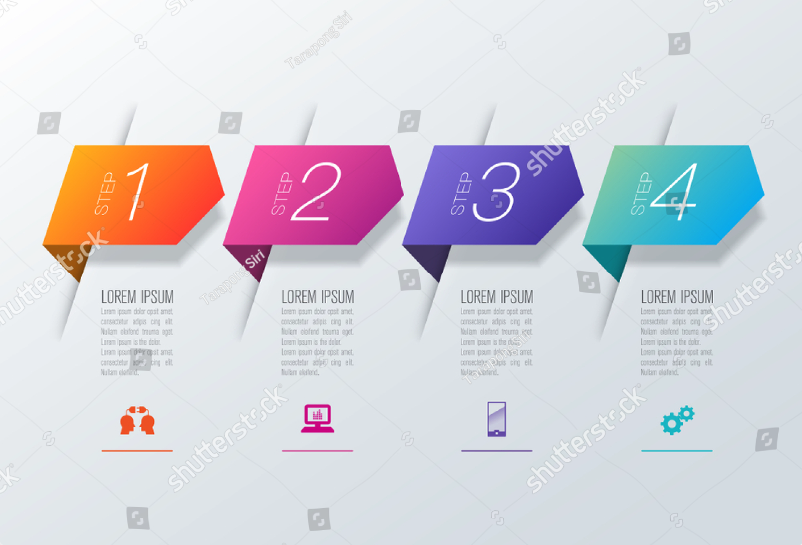
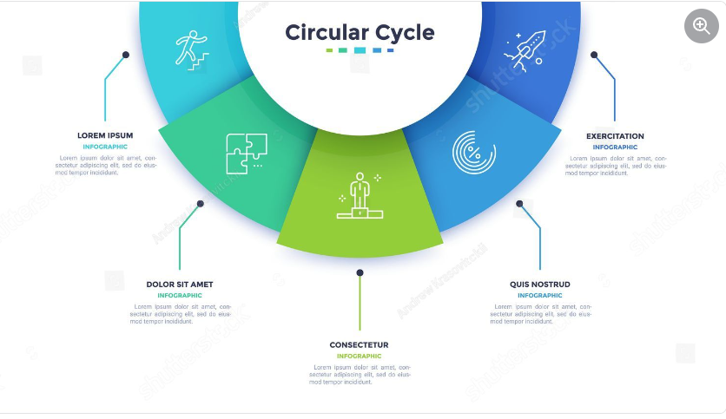
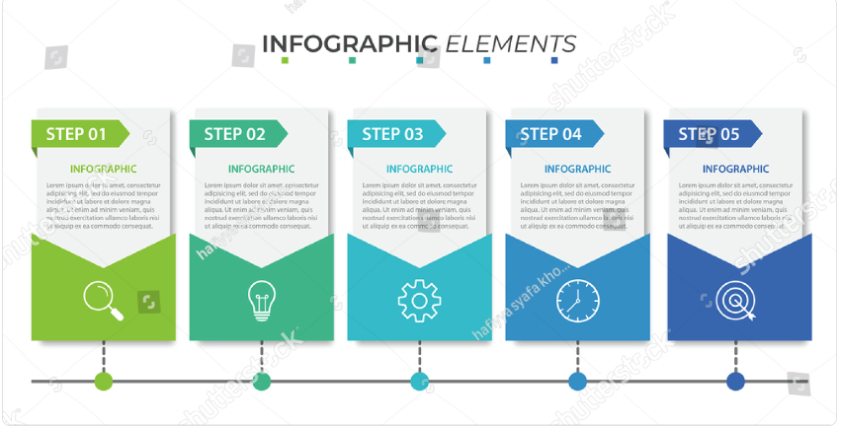


Slide 7
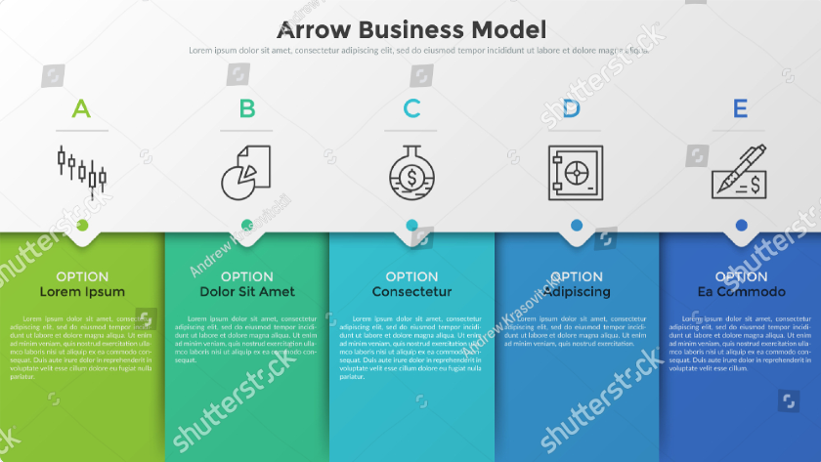
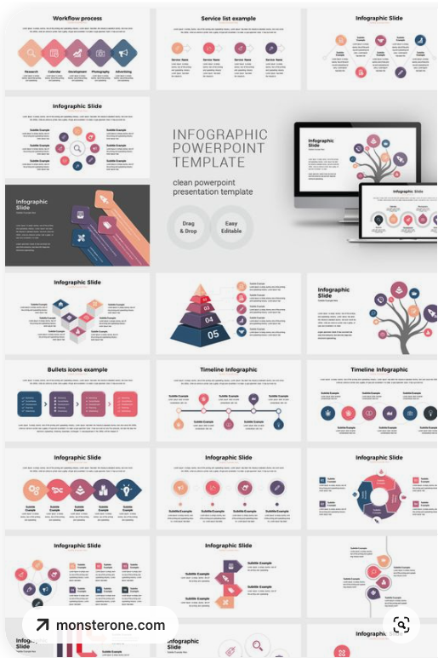
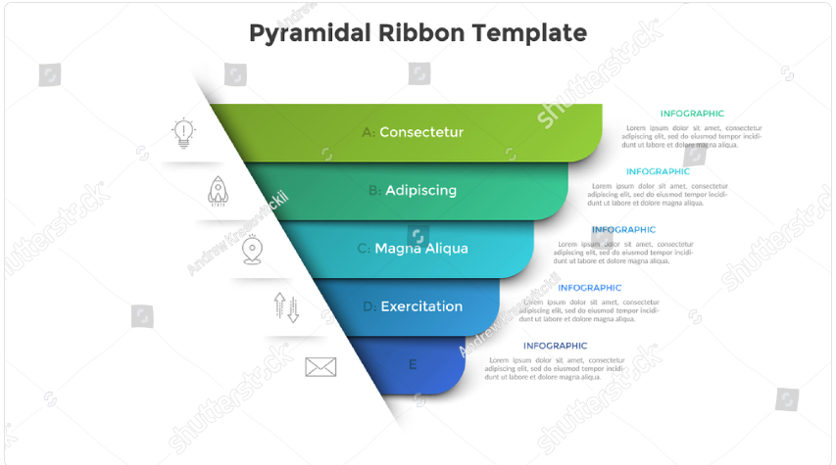

Slide 8
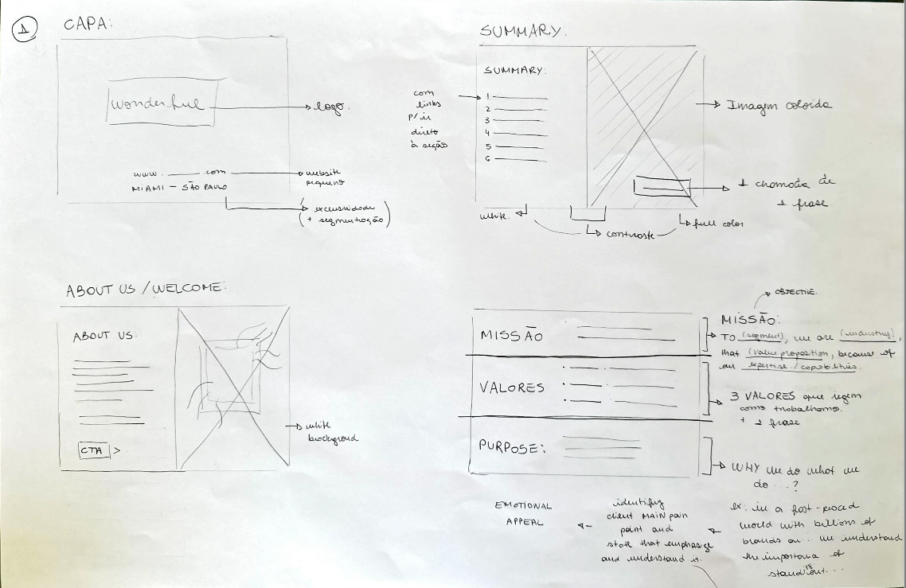

Slide 9
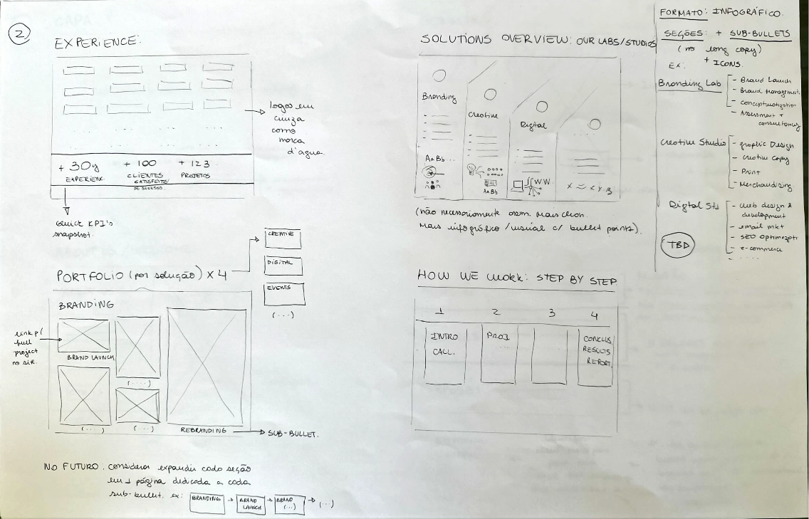

Slide 10
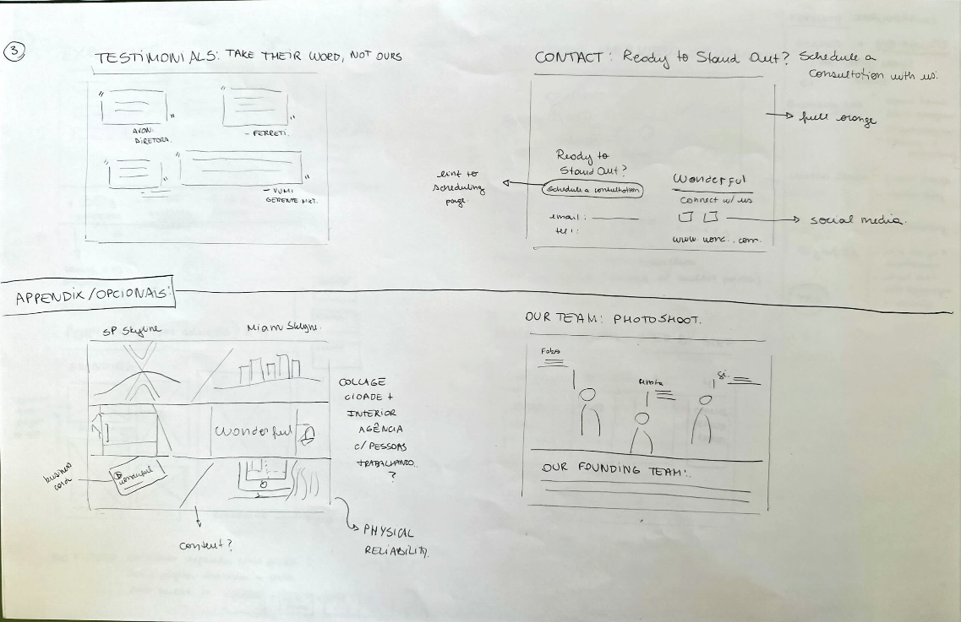

Slide 11
Links
https://2112consulting.co.uk/what-is-the-difference-between-mission-vision-purpose-values
https://www.fastppt.net/product/2-in-1-powerful-business-presentation-template/
https://br.pinterest.com/pin/613263674288834799/

Slide 12
Links Agencias
https://arsenlagency.com/?utm_medium=referral&utm_source=themanifest.com
https://helloplural.co/about/
https://thesnowagency.com/seo/
https://www.edbrig.com/?utm_medium=referral&utm_source=themanifest.com
https://www.andersoncollaborative.com/capabilities/
https://www.kobedigital.com/?utm_source=themanifest.com&utm_medium=referral
https://themanifest.com/advertising/agencies/miami

