Slide 1

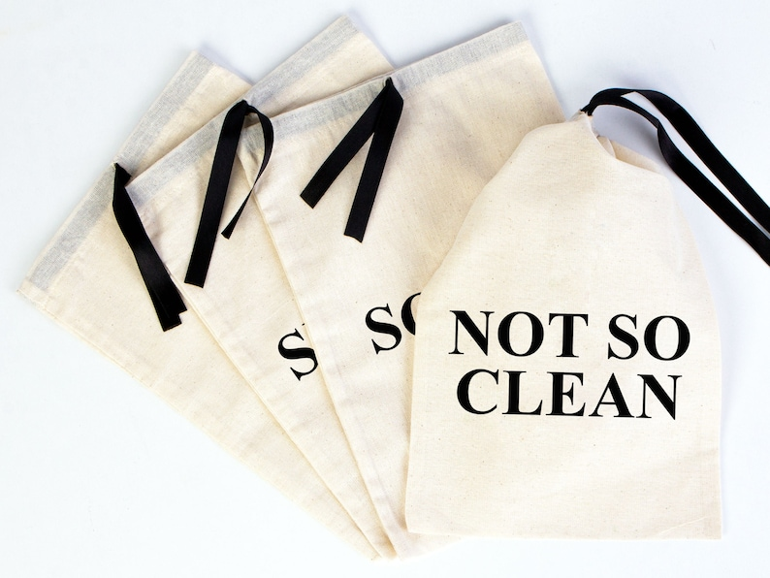
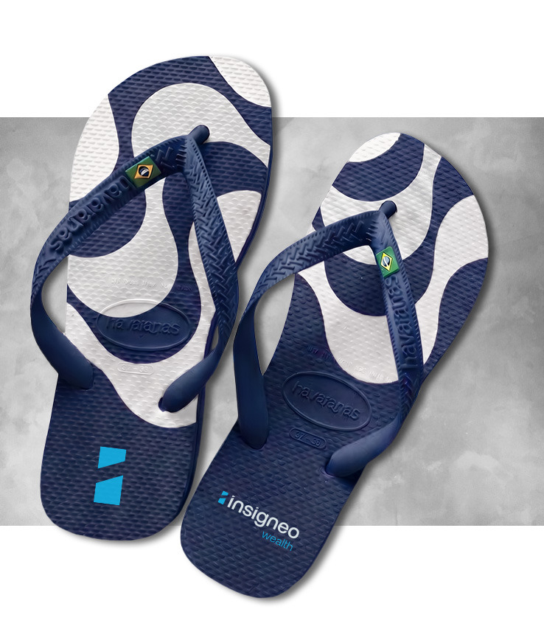
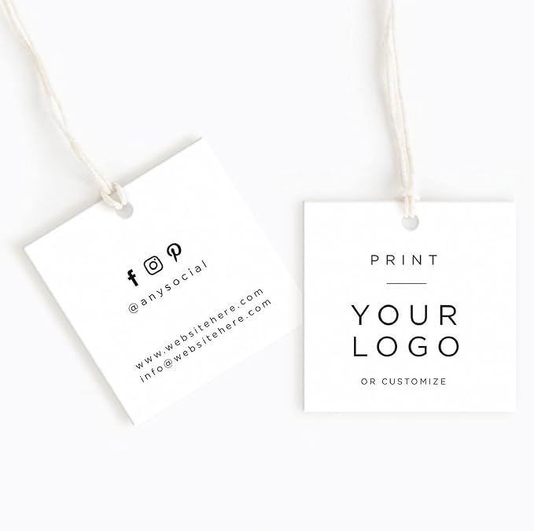
WELCOME GIFT TO ALL ATTENDEES:
1 pair of navy Insigneo Havaianas
1 linen shoe bag
1 print tag in the shoe bag
1 Welcome Card*
Order placed: 300 kits
*signed by Giovanna on behalf of the Insigneo Marketing & Events Team
Delivery: Fairmont Copacabana
Wednesday, Nov 28th 2026

Slide 2
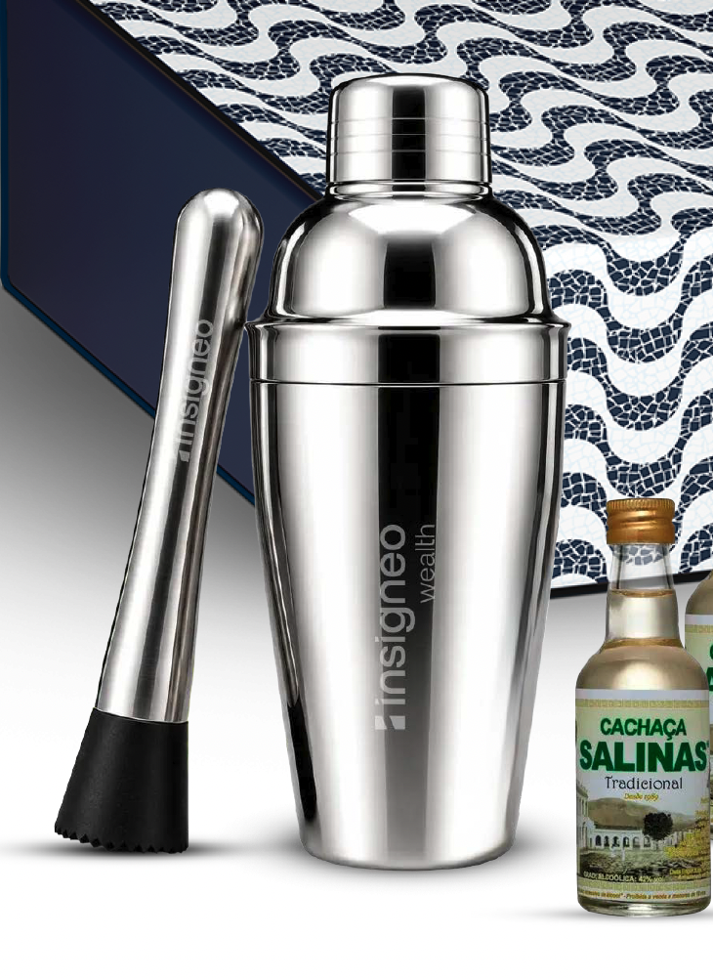
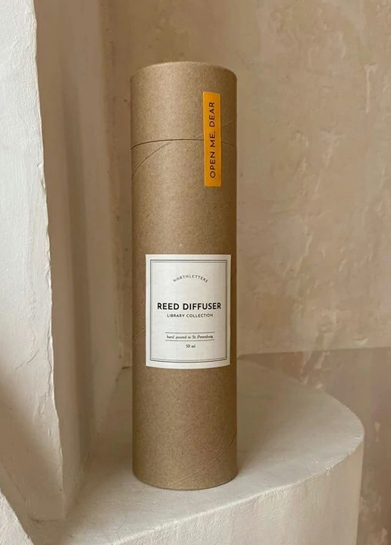
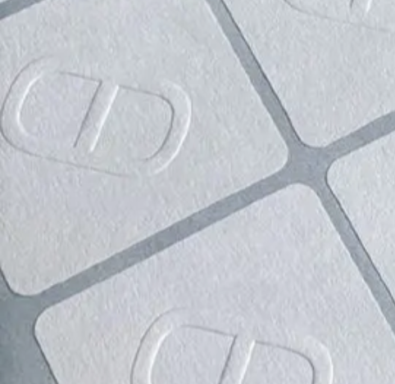
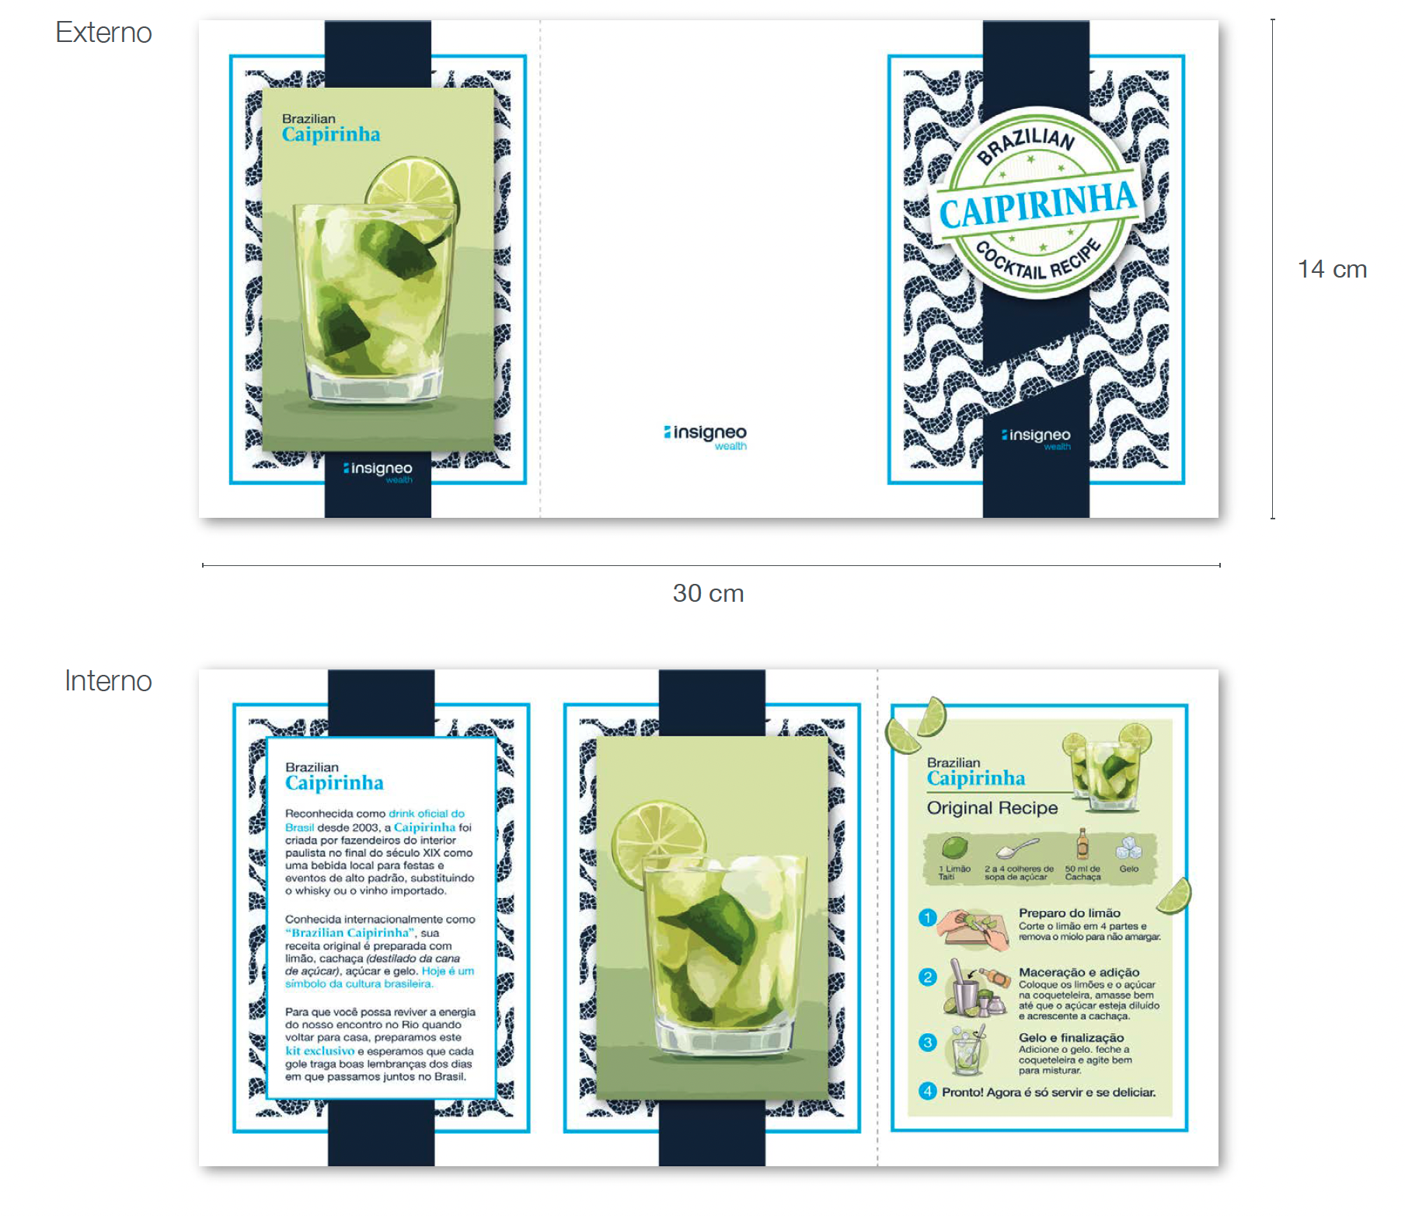
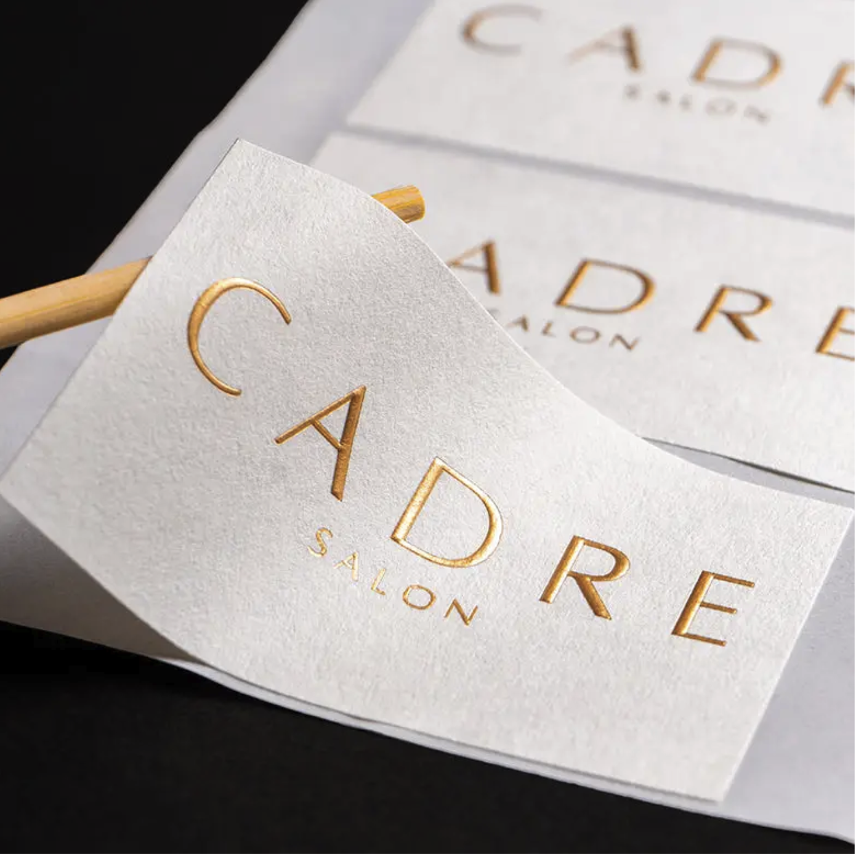
VIP WELCOME GIFT TO ICC MEMBERS:
1 cocktail mixer (stainless steel)
1 cocktail muddler (stainless steel)
1 mini cachaça
1 caipirinha recipe book (tri-fold)
1 notecard from Raul Henriquez, CEO
Package:
1 cylinder kraft tube
2 branded tissue paper
1 rectangle textured paper sticker
Order placed: 40-50 kits
Delivery: Fairmont Copacabana
Wednesday, Nov 28th 2026

